Slide 1

Project Yantra
DevSpace ‘22 IoT Track Problem Statement #1
Aakash Aditya Giri 21BCI0010
Kartik Gupta 21BCI0194
Prabhav Mishra 21BCI0155
Vellore Institute of Technology, Vellore

Slide 2
Introduction to Our Team
We at Project Yantra are an ambitious team of three first-year students who strive to make innovations in the field of Internet of Things (IoT) through communication between two robots which would further advance the supply chain management systems and reduce the time between the various logistical processes.

Slide 3
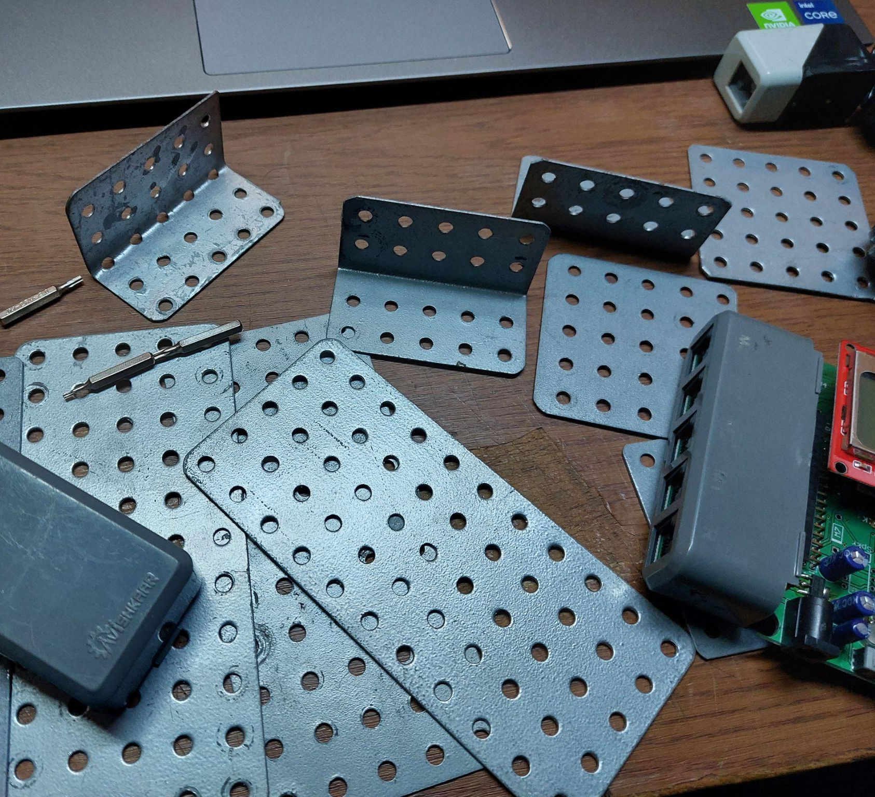
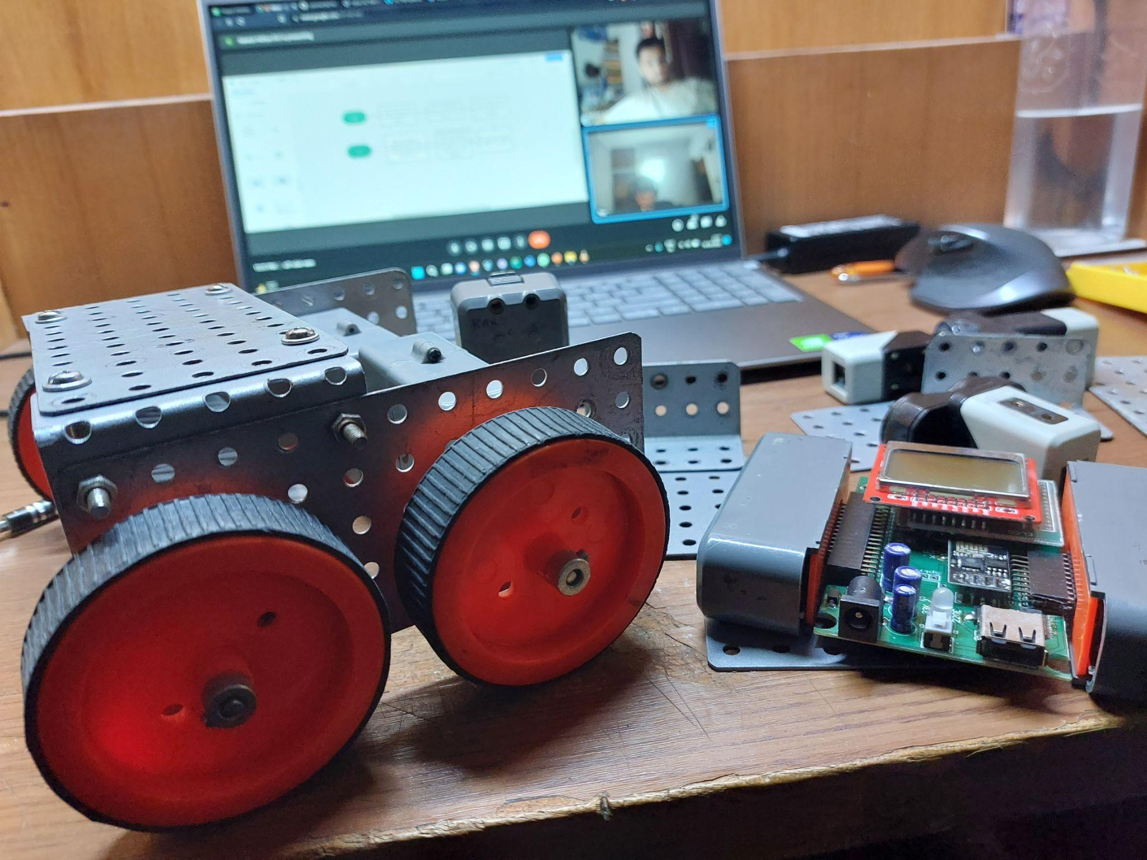
Salient Features of Our Project
Durability: It has four wheels to make it more stable and to increase the speed. Also as we have used flexi strips on the base of the robot so that the gap between the both channels remains same and hence, making it stable and durable.
Mechanism Used and Basis: Firstly, we have used the four wheeled base to increase the strength. Secondly, we have put the microcontroller vertically above the back motors so that the center of gravity is low and move faster .Thirdly, we have placed the sensors in such a way that they provide grip to the payload block.
Optimized Mechanical Design : The robot has the dimensions of 15 cm x 15 cm and has a net weight of 1.6 kg. Interestingly, the robot can carry a maximum payload of 0.6 kg. The test payload was 0.4 kg, which is 25% of the robot’s weight.

Slide 4
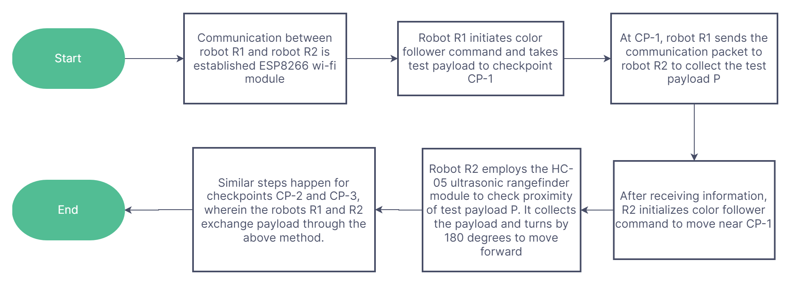
Functioning Flowchart

Slide 5
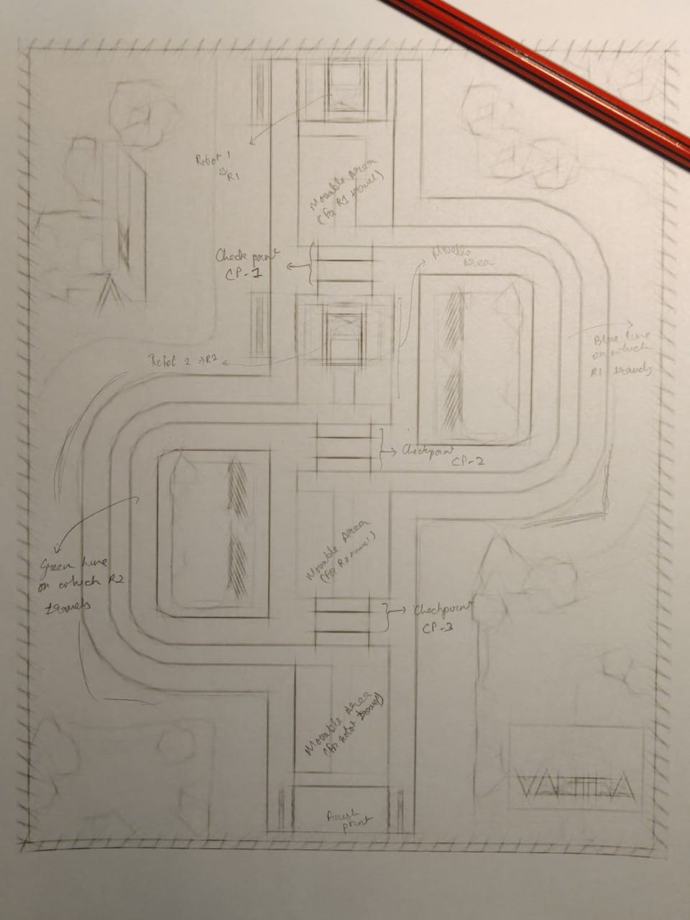
Our Arena

Slide 6
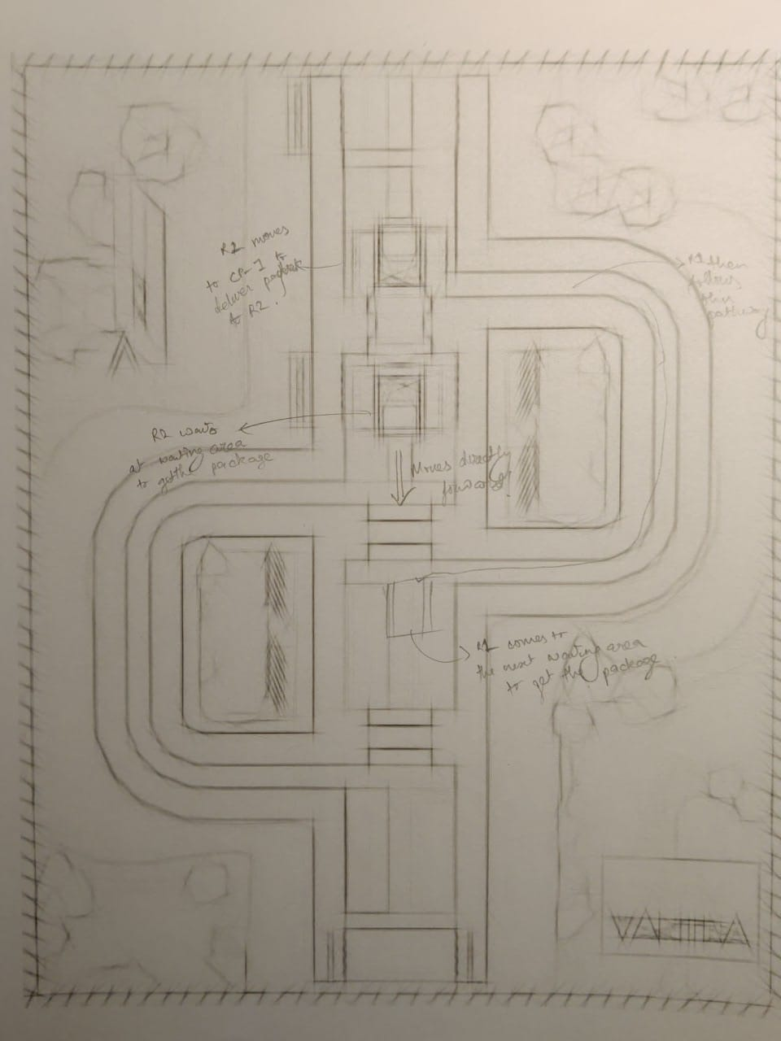
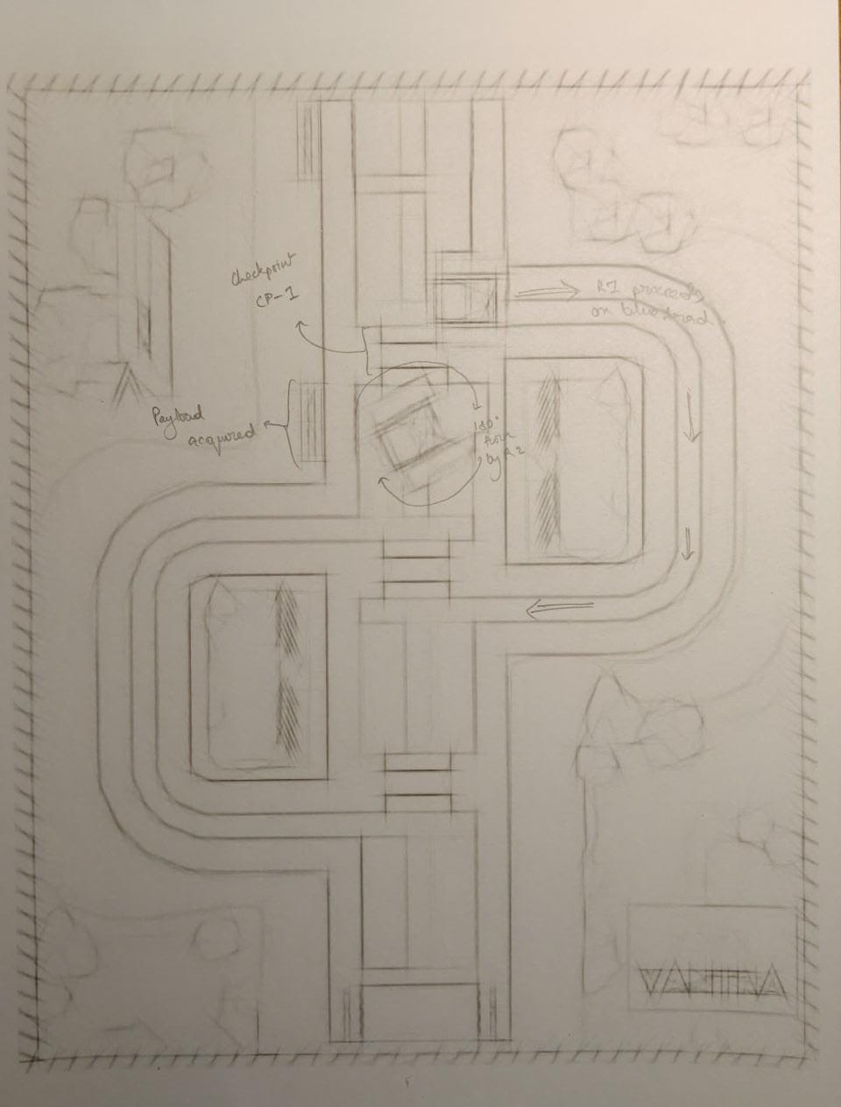
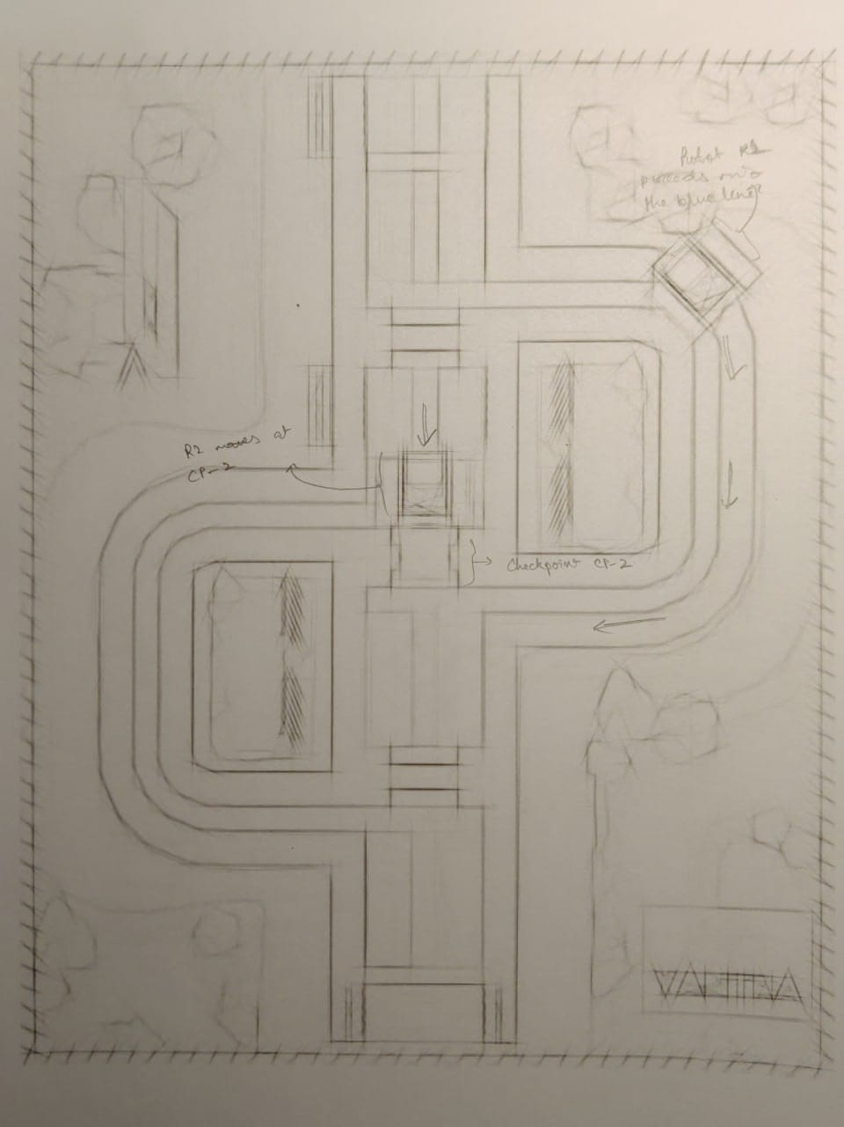
Steps in which the Robot works
Robot R1 will move the test payload P to the checkpoint CP-1, for collection by robot R2.
Robot R2 collects the test payload P from CP-1 using the HC-05 ultrasonic rangefinder module to check the proximity and move in accordance to the distance limits preset by us.
Robot R2 will then place the test payload P inside the checkpoint CP-2 for subsequent collection by R1.
1
2
3

Slide 7
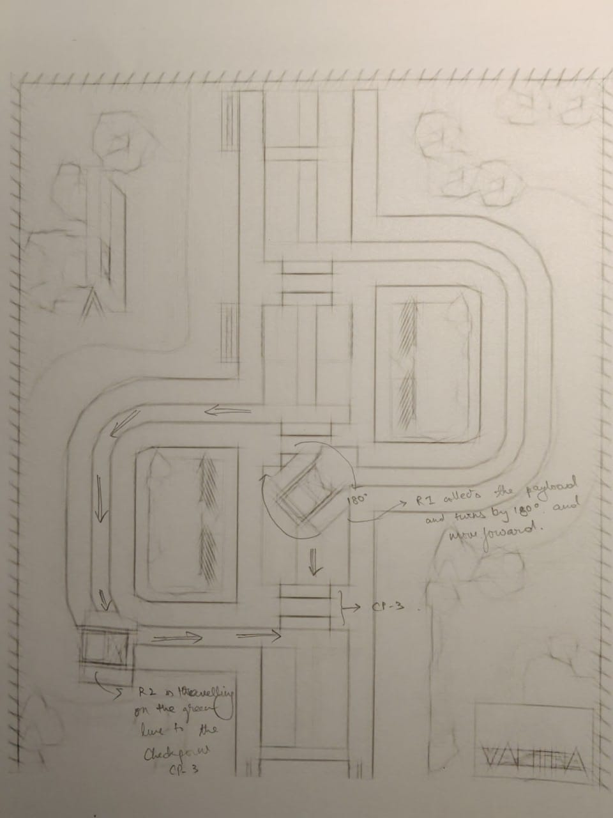
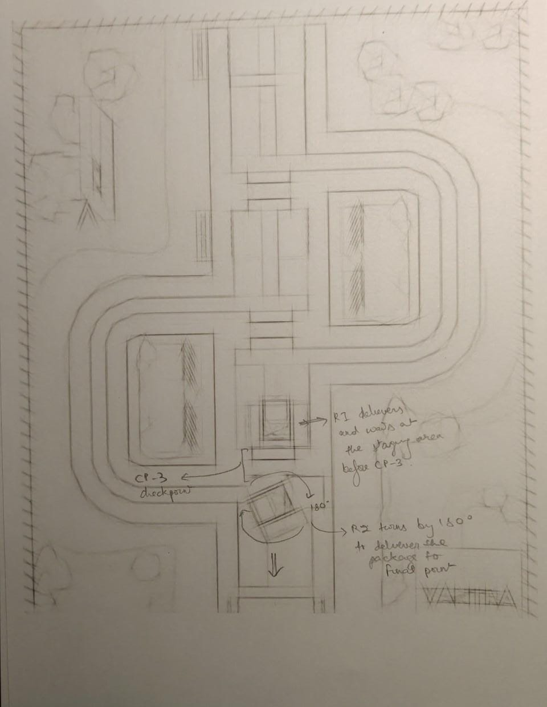
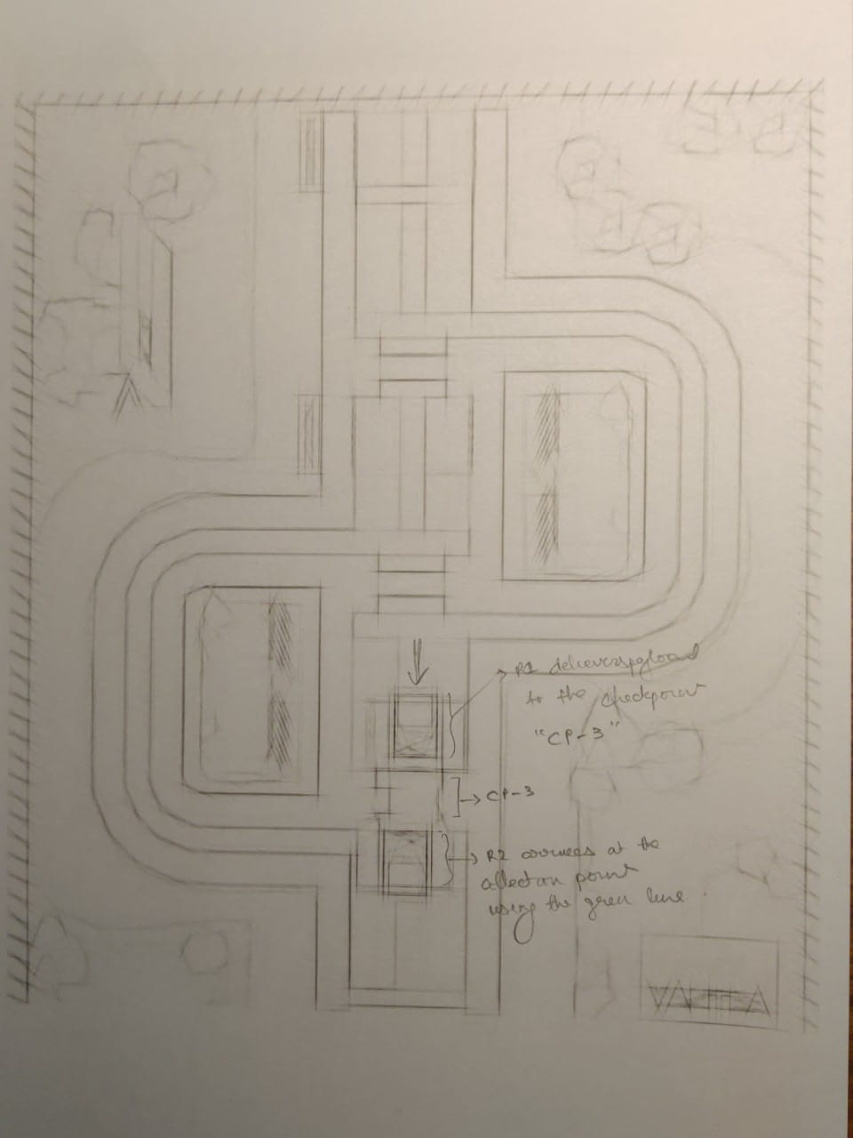
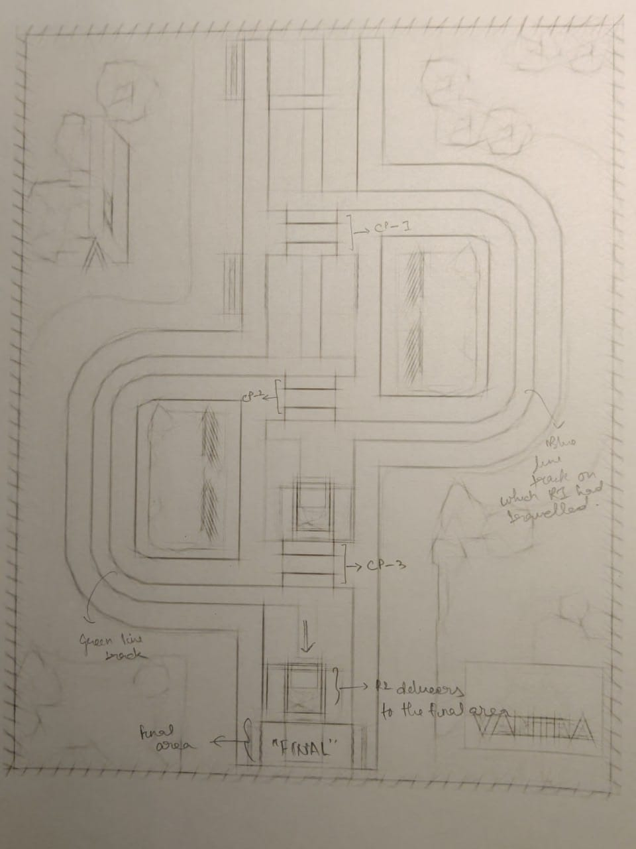
Steps in which the Robot works
4. Robot R1 will move to the checkpoint CP-2 using the blue curved line simultaneously while R2 is delivering the payload to the checkpoint.
5. R1 will then collect the payload P from CP-2 and take it further to the CP-3.
6. Now, R2 will reach the checkpoint CP-3 through the green curved line while R1 simultaneously delivers P to the same checkpoint.
7. From here, R2 again collects the payload P and delivers it to the finish point.
4
5
6
7

Slide 8
Code

Slide 9
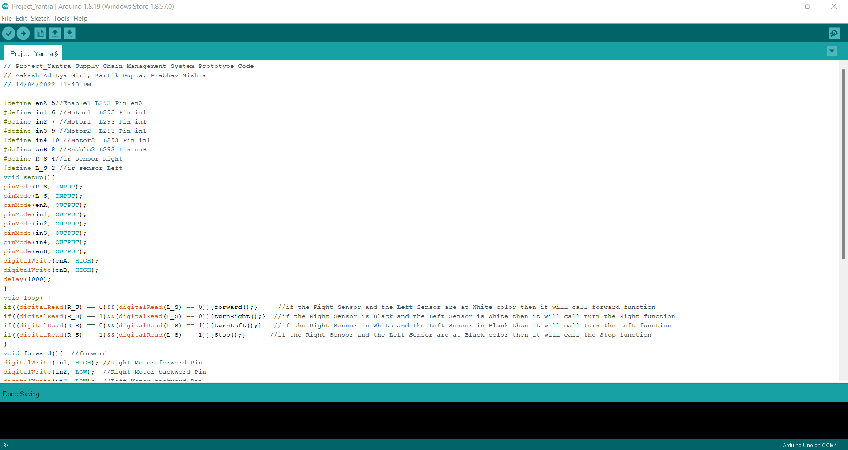
Code Development

Slide 10
Our Prototype Progress as of 8:00 AM 15/04/2022

Slide 11
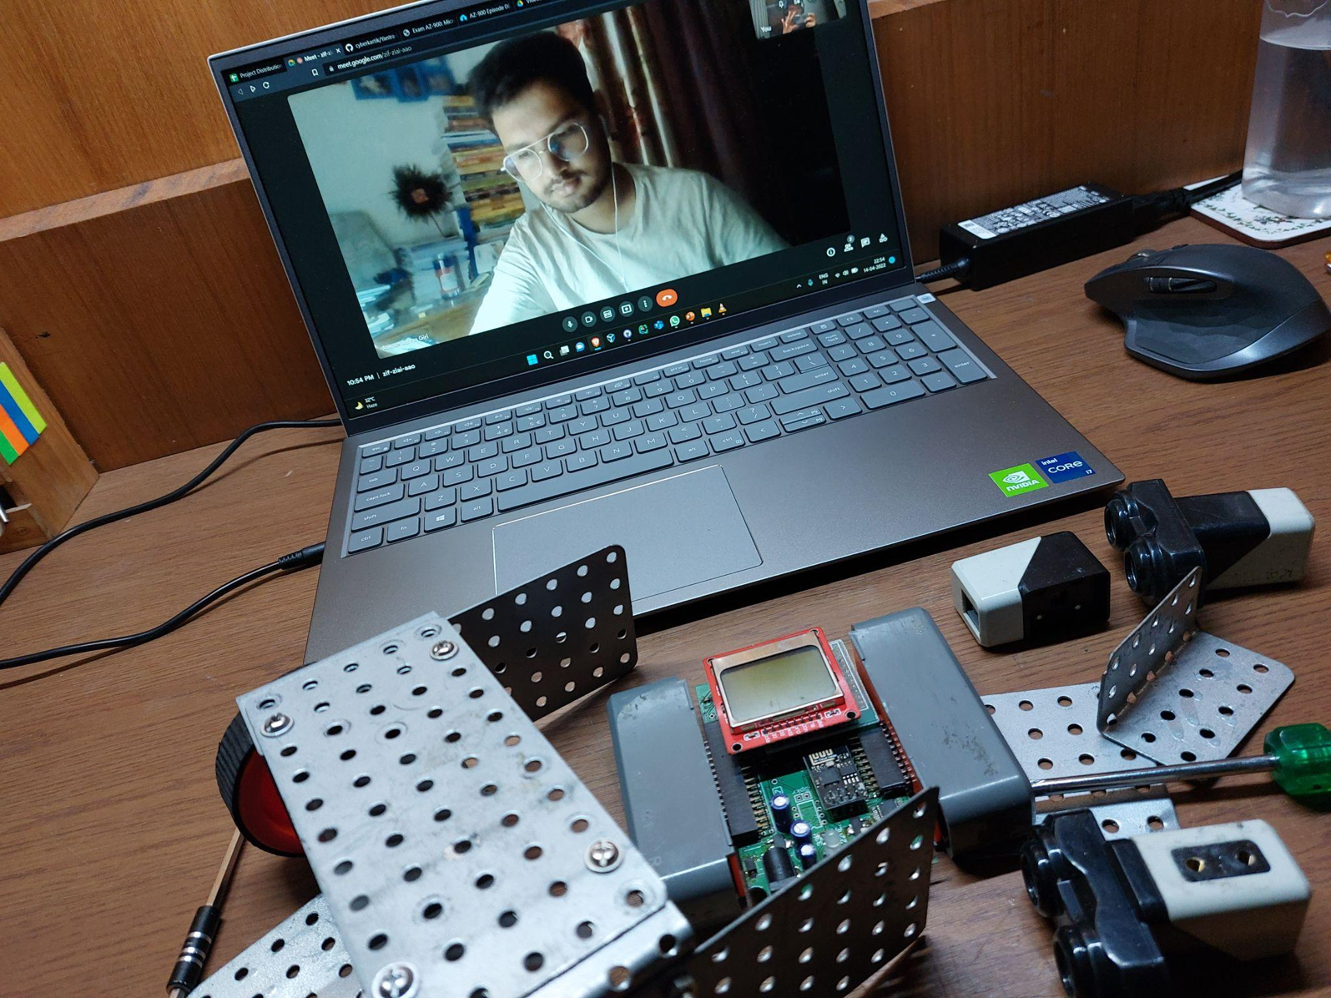
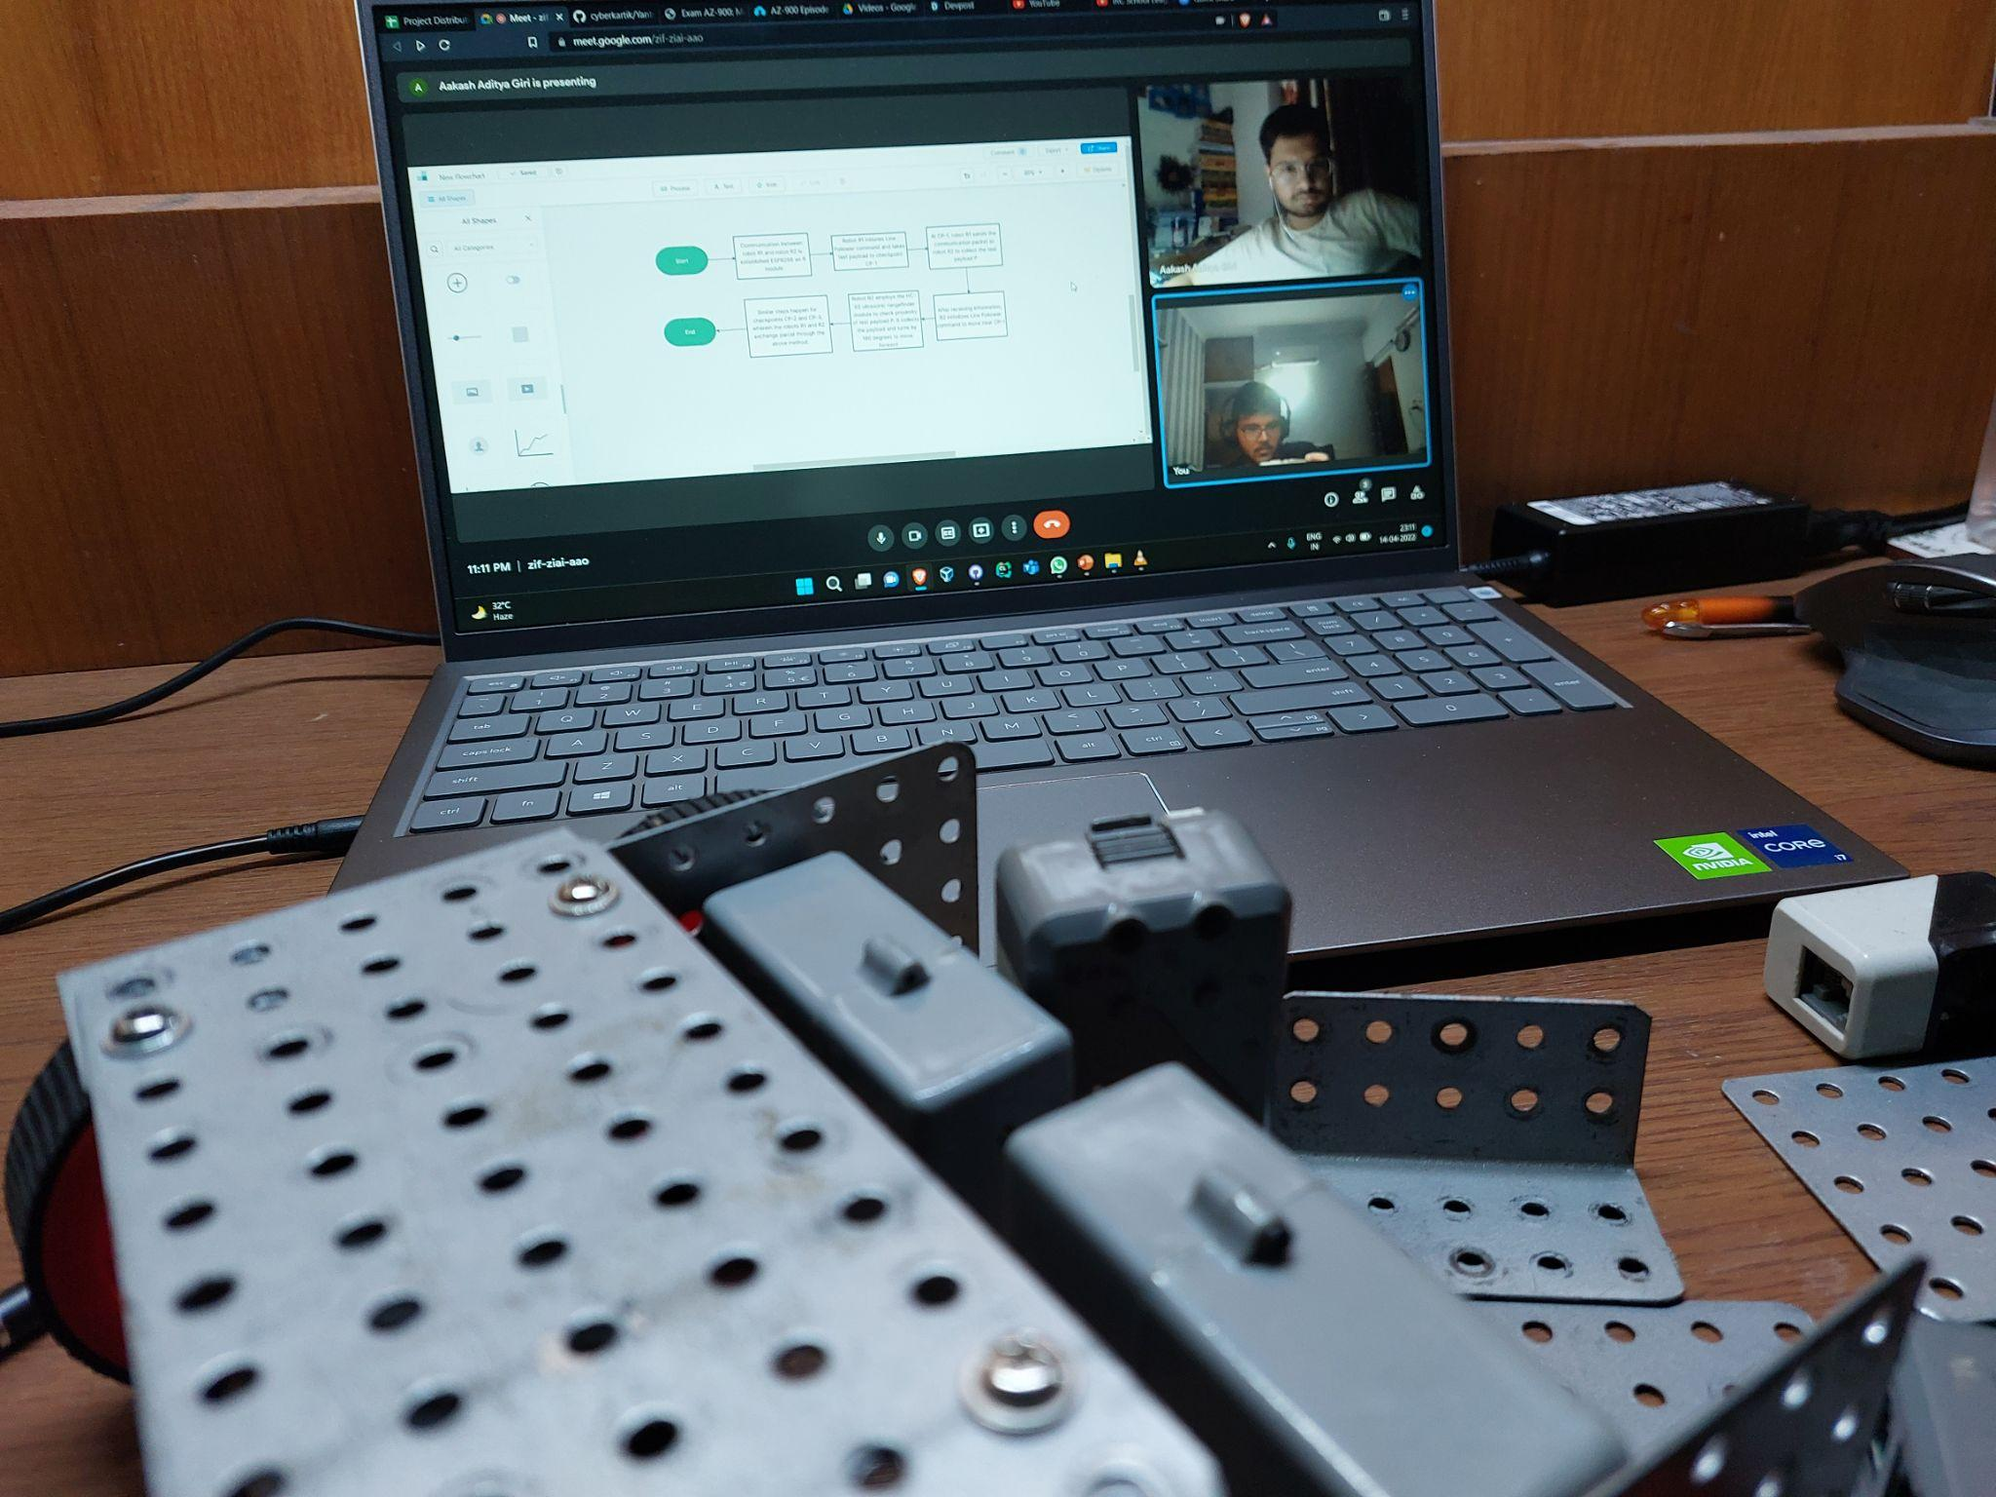
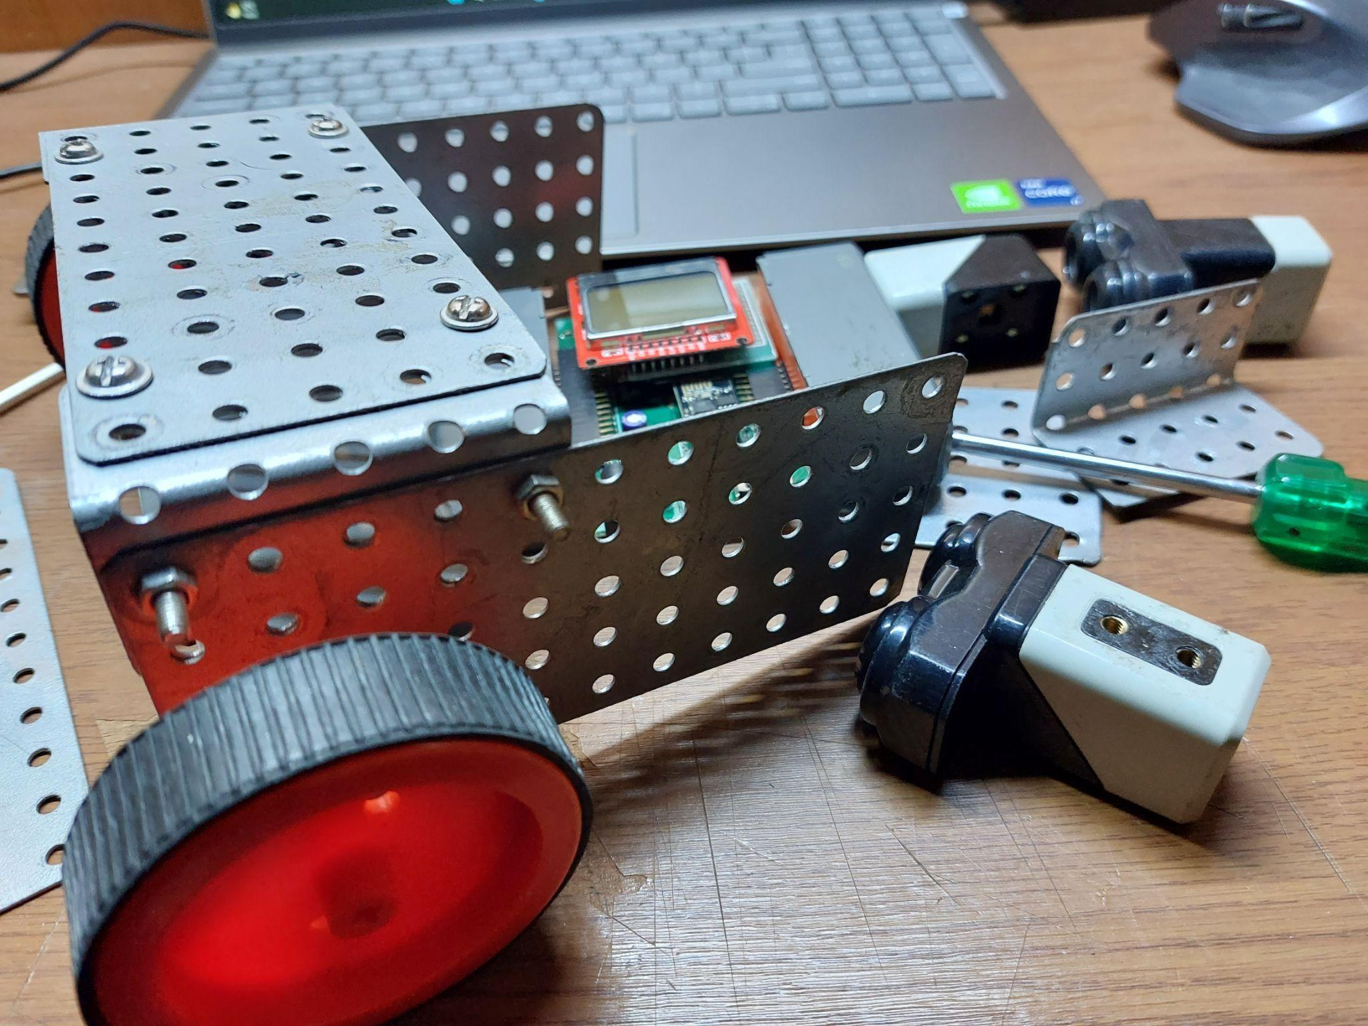
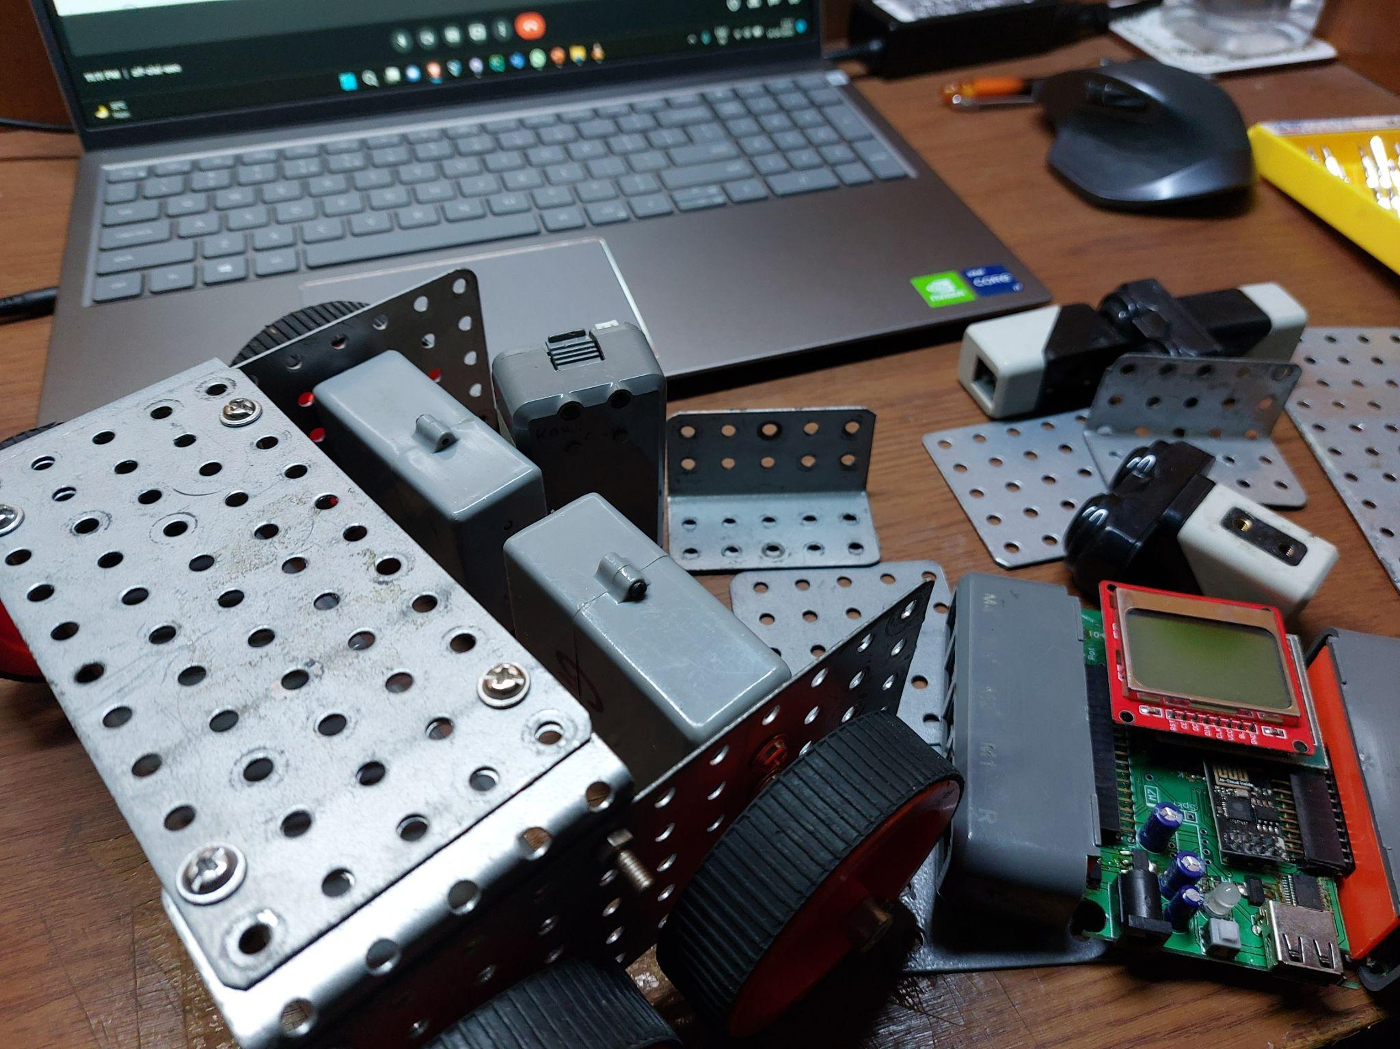
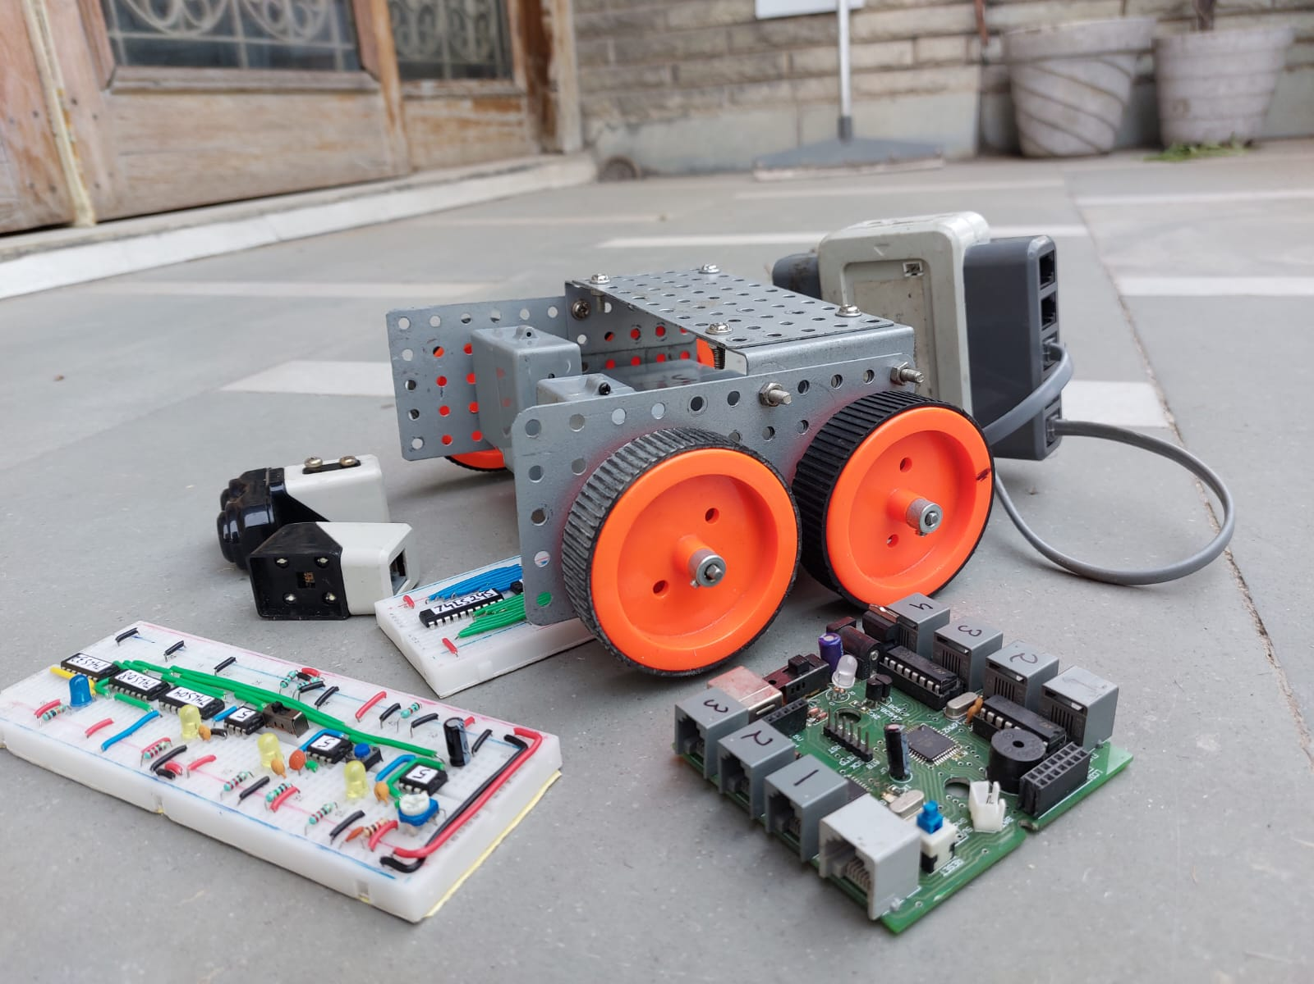
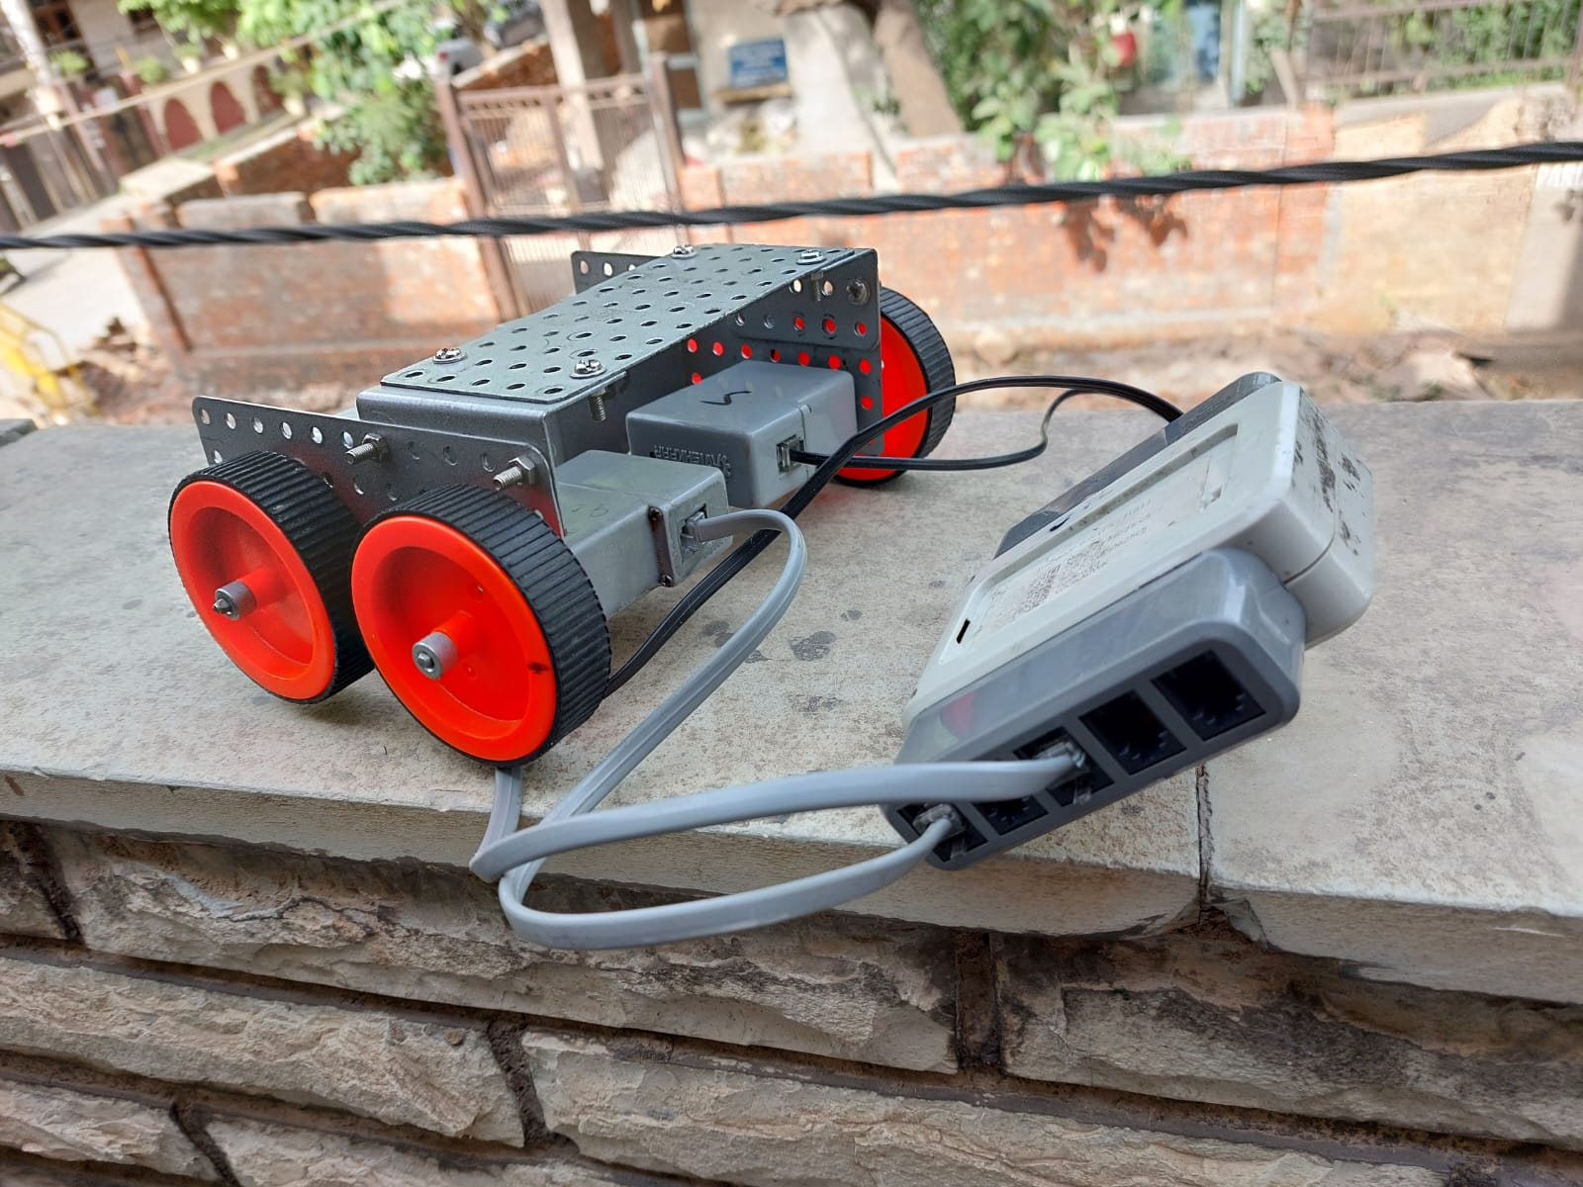
a snapshot of the gradual work done on the prototype since the commencement of the hackathon and selection of our problem statement

Slide 12
Our Prototype Progress as of 8:30 PM
15/04/2022

Slide 13
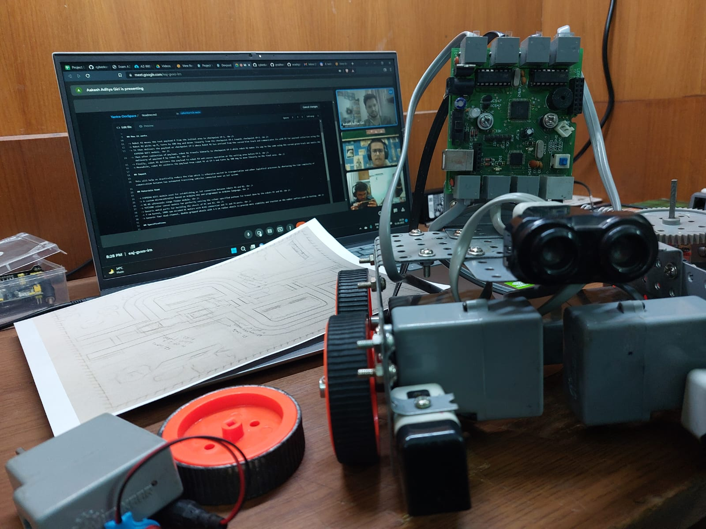
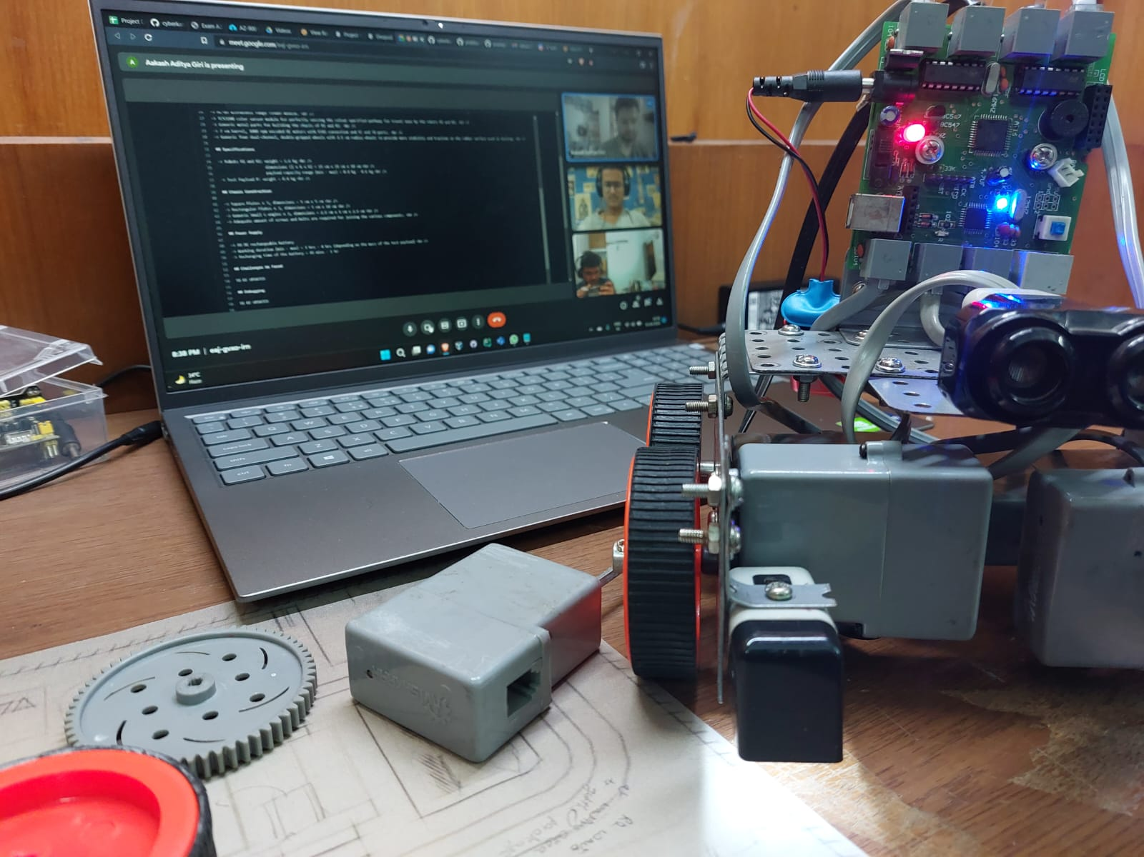
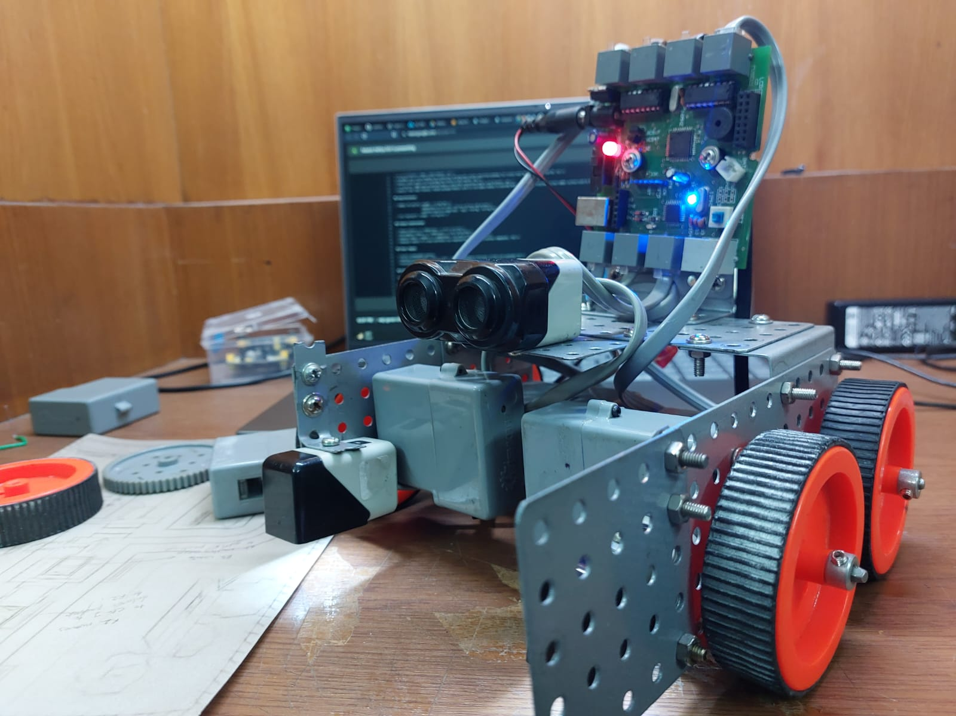
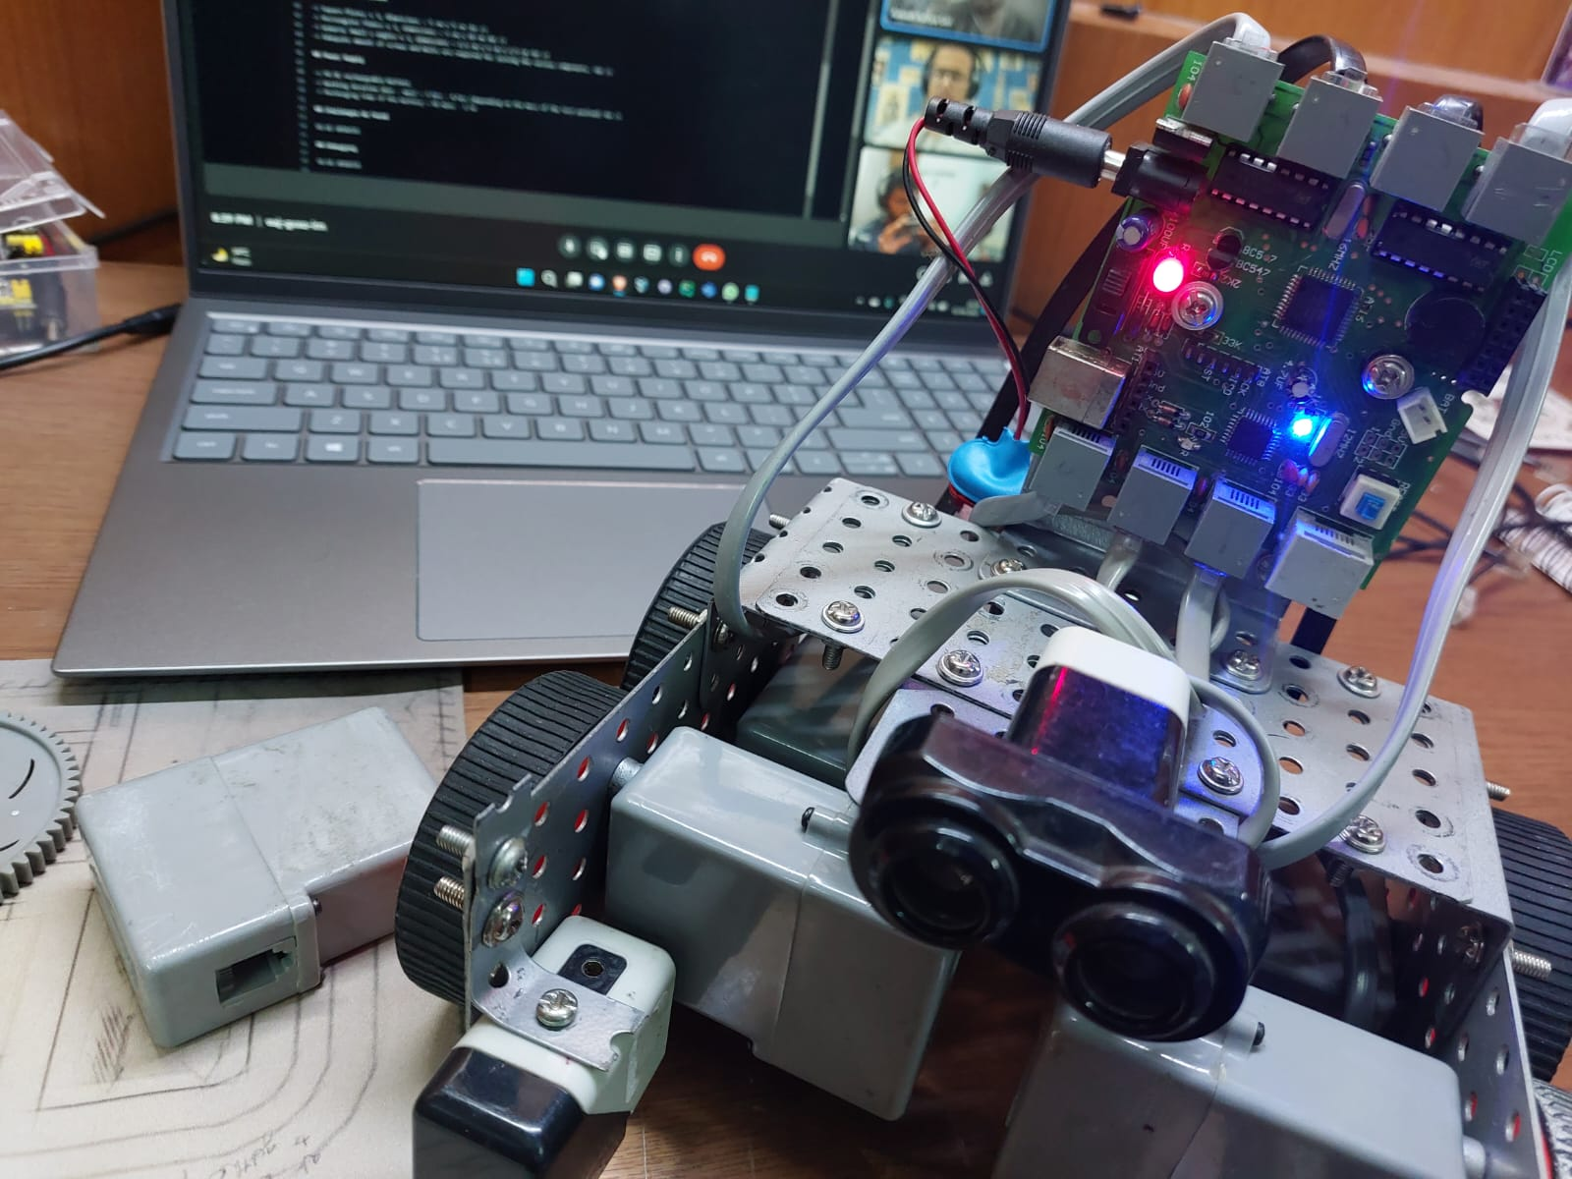
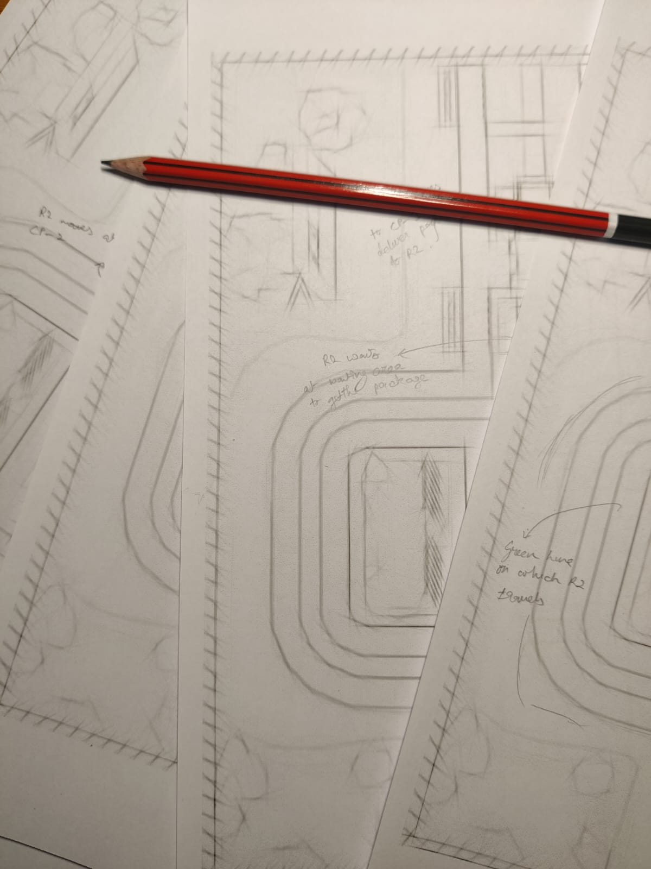
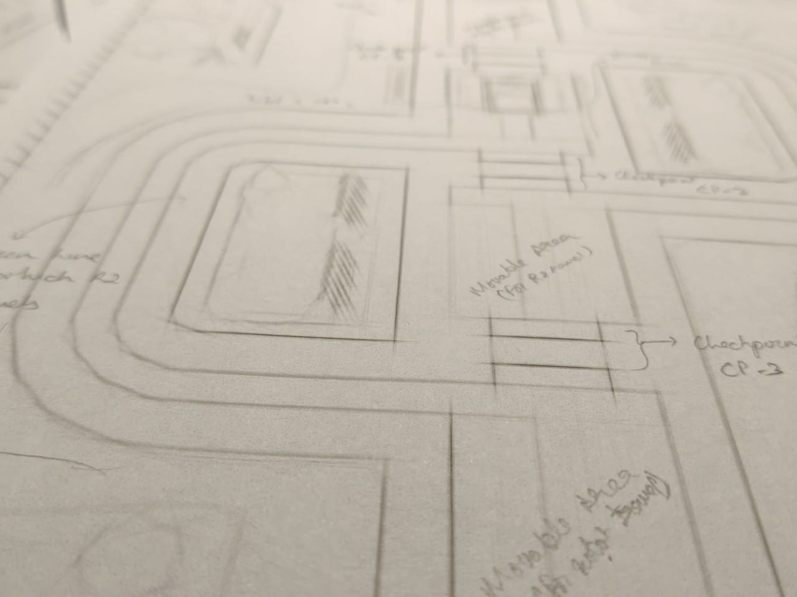
a snapshot of our progress in constructing the chassis of the robot and drafting the schematics of our arena
(the flex-print of the arena has been ordered for printing and will be available by 6:00 AM on 16/04/2022)

Slide 14
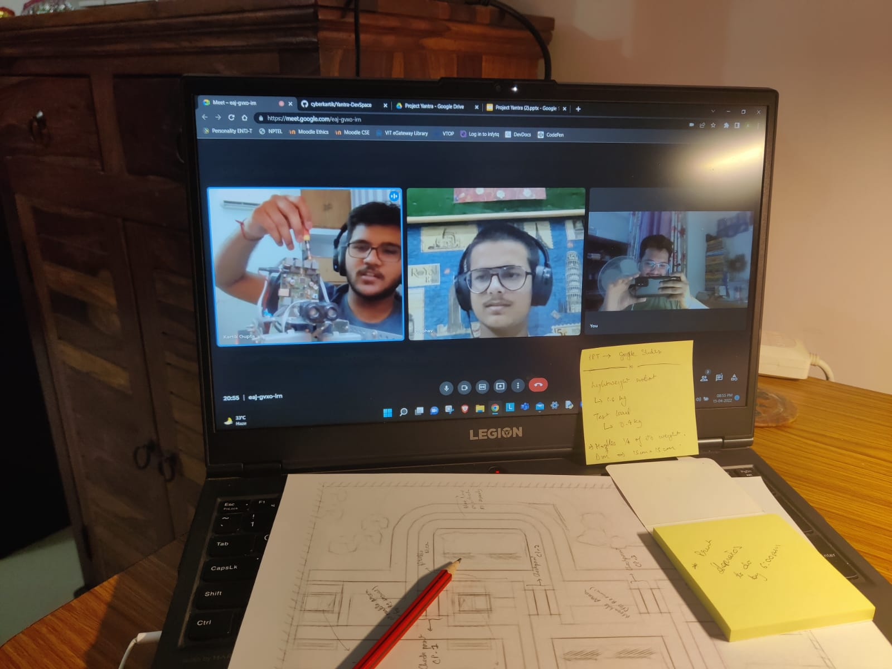
team discussion on the project

